Slide 1

Image Segmentation Using Spectral Clustering
Team - DYNAMIC DUDES
Team - DYNAMIC DUDES
AIE19013
AIE19014
AIE19062
Charan Tej. K
Ch. Surya Teja
Sugash T.M

Slide 2







STEP 02
STEP 04
STEP 06
Spectral
Clustering
Advantages
Sample Output
STEP 01
STEP 03
STEP 05
STEP 07
Introduction
Steps for Spectral Clustering
Implementation
Conclusion

Slide 3


Introduction

Slide 4


Introduction
Image Segmentation is the process of dividing an image into different regions based on the characteristics of pixels to identify objects or boundaries to simplify an image and more efficiently analyze it
Segmentation is an important stage of the image recognition system, because it extracts the objects of our interest
In our project we are going to discuss and implement image segmentation using spectral clustering method

Slide 5
Introduction
Clustering is one of the most widely used unsupervised techniques for exploratory data analysis.
Its goal is to divide the data points into several groups such that points in the same group are similar and points in different groups are dissimilar to each other.
It is up to the algorithm to find patterns in the data and group it for us and, depending on the algorithm used, we may end up with different clusters.

Slide 6
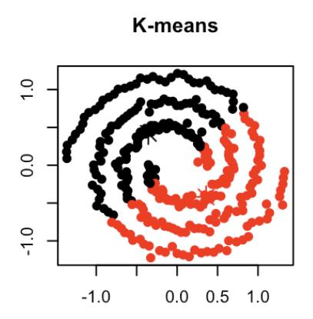
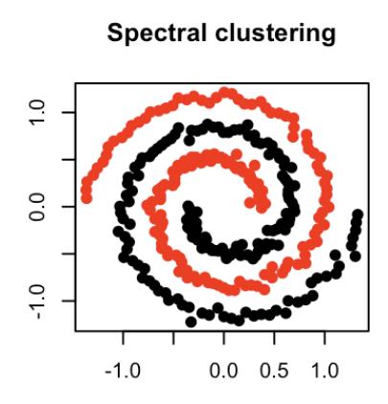
Introduction

Slide 7

Spectral Clustering

Slide 8

Spectral Clustering
Spectral clustering is a popular unsupervised machine learning algorithm which often outperforms other approaches.
Spectral clustering is a technique with roots in graph theory, where the approach is used to identify communities of nodes in a graph based on the edges connecting them
In spectral clustering, the data points are treated as nodes of a graph. Thus, clustering is treated as a graph partitioning problem. The nodes are then mapped to a low-dimensional space that can be easily segregated to form clusters.

Slide 9

Steps for Spectral clustering

Slide 10

Steps for Spectral clustering
The algorithm can be broken down into 4 basic steps.
Construct a similarity graph
Determine the Adjacency matrix W, Degree matrix D and the Laplacian matrix L
Project the data onto a low-dimensional space3
Create clusters
Typically, you will have a dataset composed of samples (rows) and their features (columns). However, the spectral clustering algorithm can only be applied to a graph of connected nodes

Slide 11
Steps for Spectral clustering
First, we construct the similarity matrix, a NxN matrix where N is the number of samples. We fill the cells with the Euclidean distance between each pair of points.
Then we create the adjacency matrix by copying the contents of the similarity matrix and we set a threshold value
The adjacency matrix can then be used to build a graph. If there’s a 1 in the cell of the adjacency matrix then we draw an edge between the nodes of the column and row

Slide 12
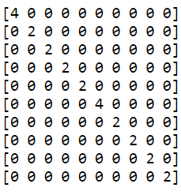
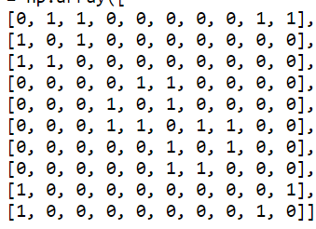
Steps for Spectral clustering
Adjacency Matrix
Degree Matrix
Once we’ve built the adjacency matrix, we construct the degree matrix. For each row of the degree matrix we fill the cell along the diagonal by summing all the elements of the corresponding row in the adjacency matrix.

Slide 13
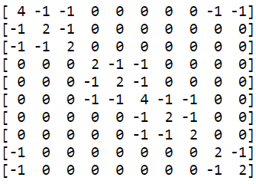

Steps for Spectral clustering
Further we compute the Laplacian matrix by subtracting the adjacency matrix from the degree matrix.
$$L=D−A$$
The Laplacian of an image highlights regions of rapid intensity change and is therefore often used for edge detection

Slide 14

Advantages

Slide 15

Advantages
The main advantage of spectral clustering is that it does not make any assumptions about the cluster shapes, and even allows clusters to “touch”, as long as the clusters have sufficient overall separation
The Second advantage of spectral clustering is its flexibility; it can find clusters of arbitrary shapes, under realistic separations.
Unlike K-means, Spectral clustering is reasonably fast for sparse data sets of several thousand elements.

Slide 16

Implementation

Slide 17

Implementation
Importing dependencies
Constructing similarity graph
Visualizing the segmented images
$$1^{st}$$
$$2^{nd}$$
$$3^{rd}$$
$$4^{th}$$
$$5^{th}$$
Reading our input images
Clustering
17

Slide 18

Sample Input and Output

Slide 19

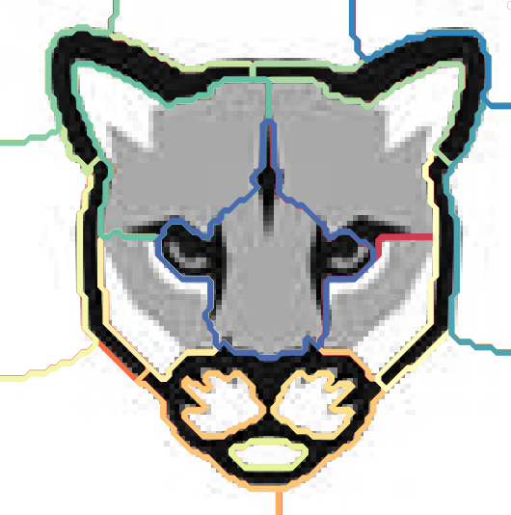

Output

Slide 20
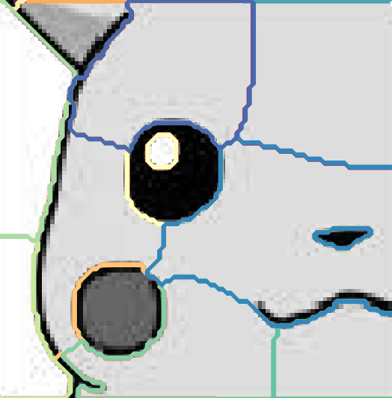

Output

Slide 21

Conclusion
To the best of our knowledge, we have explained about the string reconstruction approach for the genome assembly using Hamiltonian Path and have successfully implemented it.
Finally, we conclude by saying that we as a team understood the importance of genome and the assembling a genome through string reconstruction and the various algorithms related to it

Slide 22

☺☺☺☺☺☺☺☺☺☺☺☺☺☺☺☺☺☺☺☺
Thank You
☺☺☺☺☺☺☺☺☺☺☺☺☺☺☺☺☺☺☺☺

